Slide 1
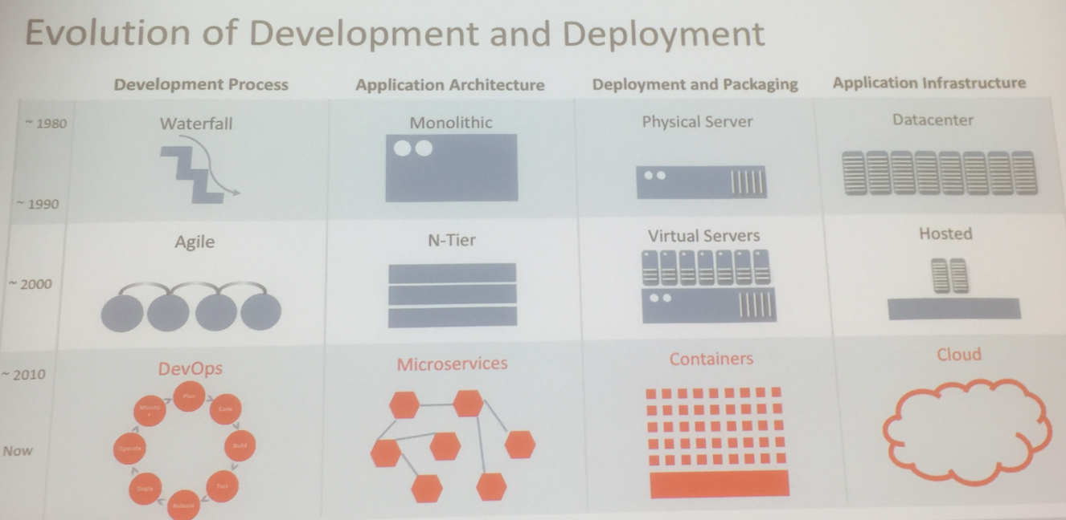

Slide 2
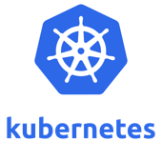
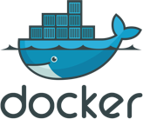
The Containerization Journey
Managed Services
Kubernetes
Docker
Speed Efficiency Agility
Phase III
Business Focus
Phase II
DevOps Focus
Phase I
Developer Focus
Container Adoption
Application Deployment
Business Integration
Focus:
Applications:
Automation:
Community:
Developer adoption
Dev/Test apps
Simple orchestration
Individual developers
DevOps deployment
Production apps
Advanced orchestration
Teams & lines of business
Broad integration
Business apps
Self Service management
Enterprises

Slide 3




Oracle Cloud Infrastructure Application Platform
Enterprise Applications
Cloud Native Applications Micro Services, Big Data, AI/ML
Cloud Applications
Database Cloud
Cloud Platform
Hypervisors
Container Services
Application Services
Oracle RDBMS, Oracle RAC, Exadata
Java, Big Data, Mobile, Integration Services
Run VMWare / KVM
Docker, Kubernetes, Serverless Functions
Monitoring and Management
Streaming and Pipelines
Developer Tools
DevOps Tools and Services
Next Layer Services
Cloud Infrastructure
25 GB Network
Bare Metal
VM
GPU
NVMe SSD
Block Storage
File Storage
Object Storage
Core Services

Slide 4
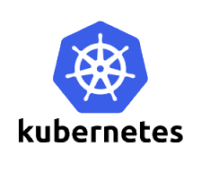

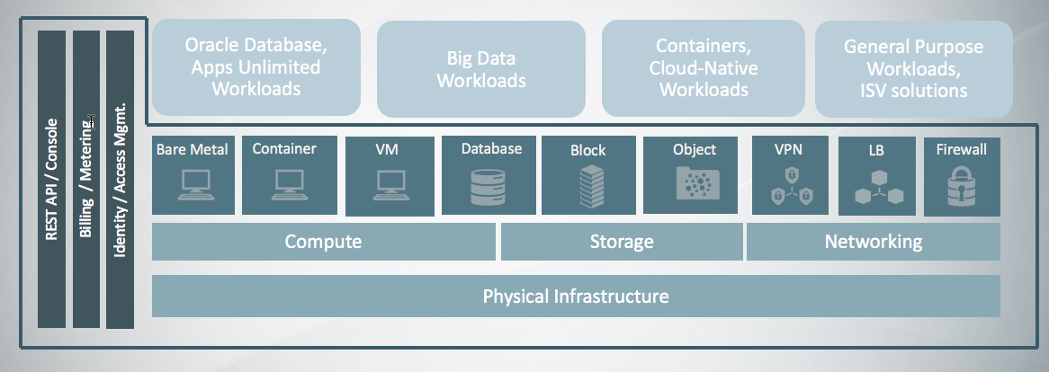
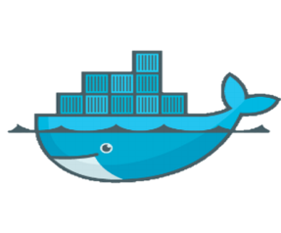


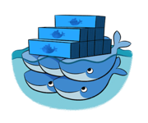

Oracle Cloud Infrastructure and Kubernetes
Roll Your Own, Pre-Built Installer, Managed Service
OCI
Quickstart Experience OSS Terraform Installer on GitHub
OCI Container Engine
for Kubernetes (OKE)
DIY Container Management
Self Managed Kubernetes Service
Enterprise Class Managed Kubernetes Service
IaaS
CaaS

Slide 5
Addressing Microservices Challenges
Average Oracle customers will not want to deploy and manage Kubernetes, Istio, & complex dependencies!
Challenge
Service Mesh: Robust, resilient network with flexible routing
Observability: Detailed Debugging, Request tracing, and Self Healing
Access Control: Provide rich set of policies for fine grained access
Integrations: Satisfy external dependencies like databases, queuing , & caching
Eventing: Dynamic, flexible interconnections between services
API-first development: Strong API contracts between services
Ease of Java Development: Attract Java EE Developers via lightweight runtime
Continuous Integration and Deployment: Improve Deployment Management
Architectural concerns
Developer Experience​

Slide 6
Kubernetes Platform Services Goals
Simplify the experience for the average Enterprise developer building Kubernetes-based microservices on OKE/OCI
Lower the barrier to entry
Similar model to what we did for Java EE with Oracle customers
Deliver a set of tools, integrations and new services that makes OKE a richer platform to Build, Deploy and Operate containerized applications and workloads.

Slide 7
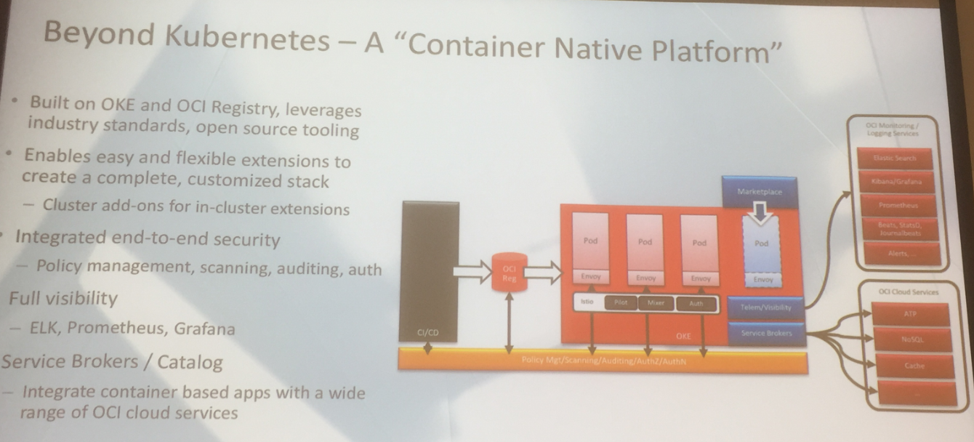








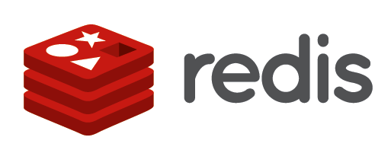


Oracle Cloud & Container Native Microservices Architecture – October 2018
Notes:
Beyond Kubernetes - A "Container Native Platform"
Built on OKE and OCI Registry, leverages industry standards, open source tooling
Enables easy and flexible extensions to create a complete, customized stack
F — Cluster add-ons for in-cluster extensions
’ Integrated end-to-end security - Policy management, scanning, auditing, auth
Full visibility
- ELK, Prometheus, Grafana
Service Brokers / Catalog
- Integrate container based apps with a wide range of OCI cloud services

Slide 8
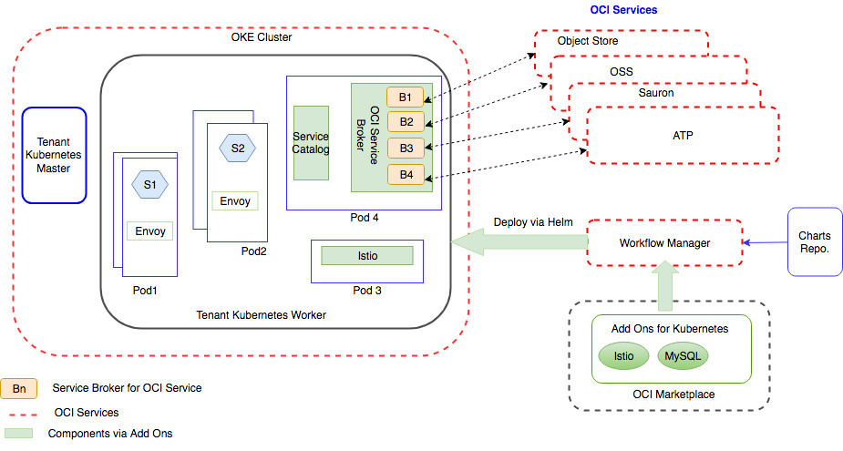
Kubernetes Platform Services on OKE
Notes:
Initiatives in the initial phase
Helm Workflow Manager
Enhanced industrial strength Workflow Manager complementing OKE cluster lifecycle
Foundational component for MPK
Service Catalog
In Cluster Service Catalog and OSB based Service Broker enabling binding OCI Services
Add on Store
Integration with OCI Marketplace for Add Ons enabling installing OSS components on OKE
Managed Istio / Istio via Add Ons catalog
Out of the box support for Istio on OKE clusters
Available as a Add On in the short term
Telemetry and Logging - Sauron
Container Native integration for Prometheus and ELK stack ( CNCF tools
Helm Workflow Manager
Drive the installation and management of components to an OKE cluster
Reliable workflow based on Helm
Enable installation of components during cluster creation as well additional components from the Add On store on an existing cluster
Foundational component for
Istio,
Service Broker
Event Broker
Extend the OCI Market place to host OSS components which are Kubernetes native
Enables applications to use components that are not yet available as managed services
E.g. Caching layer, OSS queuing layer
Integrate with Helm Workflow Manager to deploy and manage these components on OKE
Extend the Market place UI

Slide 9
Service Mesh
A service mesh is a software infrastructure layer for controlling and monitoring internal, service-to-service traffic in microservices applications. It typically takes the form of a “data plane” of network proxies deployed alongside application code, and a “control plane” for interacting with these proxies. In this model, developers (“service owners”) are blissfully unaware of the existence of the service mesh, while operators (“platform engineers”) are granted a new set of tools for ensuring reliability, security and visibility.
The service mesh is ultimately not an introduction of new functionality, but rather a shift in where functionality is located.

Slide 10
Benefits
Routing / traffic shaping
Adaptive/client-side load balancing
Service discovery
Circuit breaking
Timeouts/retries
Rate limiting
Metrics/logging/tracing
Fault injection

Slide 11
Timeouts and Retries
Timeouts and retries can be handled at the service mesh layer
Behavior is adjustable but consistent
Supports polyglot development
Saves Application developer from having to implement or explicitly include logic
Application Code
Get
Response
Proxy
Service
Get
Timeout
Get
Timeout
Get
Response

Slide 12
Circuit Breaker
Transparently monitors for connection failures
Failures beyond a threshold limit trigger the circuit breaker to open
Subsequent requests fail fast
After timer triggers, a ’test request’ will be allowed to pass through
Circuit state will be set based on result of that request
Prevents flooding a failed service with retries
Failure
(Beyond Threshold)
Open
Failure
Closed
Success
Failure
Reset Timer
Half Open
Success

Slide 13
Canary Deployment
Clients
Controlled upgrades, transparent to user
Portion of traffic is redirected, success is validated, then more traffic is redirected
Eventually, all traffic is redirected and old version can be removed
Can be rolled back any time using same approach
No animals harmed
Closed
Service
Version 1
Version 2
Monitor and Verify

Slide 14
Distributed Tracing
Visualization of request across multiple services
Easy to see where time is spent, parallelism, etc
Helps identify issues and optimization opportunities
Would be extremely time consuming to collect, associate and coordinate through raw log files

Slide 15
Microservices Require Robust API Management
Microservices architecture breaks down services and assets into discrete, composable units. And they use APIs to communicate and connect with each other. Which in turn means dev teams are needing to build up their API design and creation skills (which requires testing and other ops tasks), as well as outsource functionality like security and resiliency.
“If you get your API wrong the first time around, it is really expensive to fix it” — Alex Salazar.
The strength of Microservices is their independence, and a strong API contract is the only way to maintain that.

Slide 16
API Registry
Driving the API first approach
Consumer and producer of an API agree on its definition
Capture it in code (swagger, blueprint)
Publish the API to the registry
Then consumers can develop against a generated mock producer while the producer is developing the actual code
API Registry can generate client libraries (Java, Javascript)
API Registry can be used for discovery of implementing services
API becomes a living, evolving, contract
Complimentary to Apiary, consuming and implementing Apiary output

Slide 17
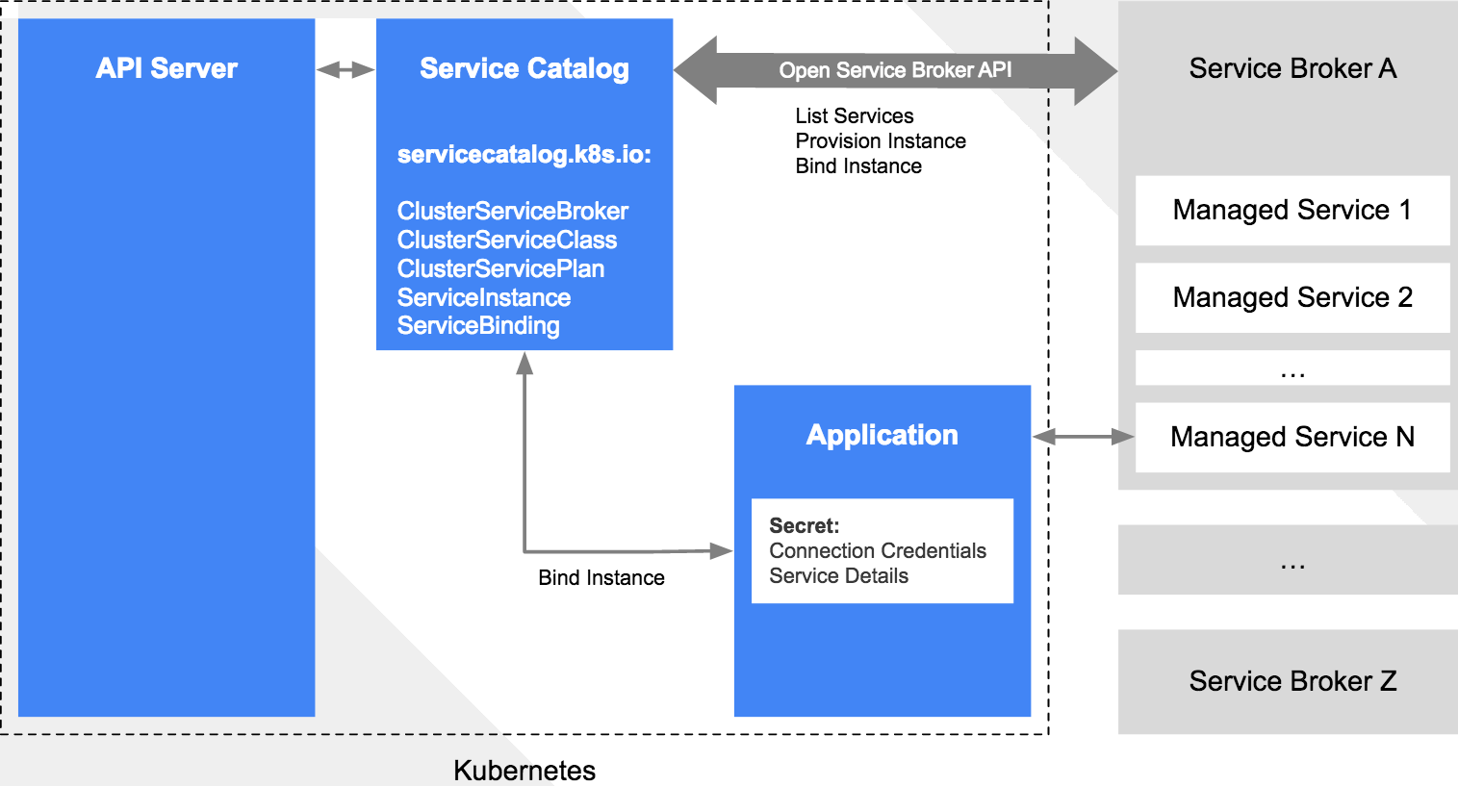
Open Service Broker API – What the spec defines
Notes:
Talk to the picture, How SB arch is currently implemented
Managed Service == PAAS Service

Slide 18
Service Broker Marketplace
Marketplace makes service brokers easy to register, easy to use, provides a single operation to provision and connect to services
Services may be provisioned within the cluster or externally
Many brokers can be supported to provide a wide range of services
Service brokers written to standards can be included in any cloud provider’s Kubernetes platform, making it easy for Oracle and non-Oracle platforms to consume Oracle services
Can include the new OpenPaaSServiceBroker to provision PaaS services

Slide 19
Some notes on OKE
Easy install of OKE Cluster (without manual preparation) – end of October
Work is done on Terminal in browser
Suggested: offer K8S dashboard in Cloud
So no kubectl proxy
And perhaps: enhanced dashboard (like Google Cloud)
Autoscaling at Pod or Node level is worked on
Federated K8S is worked on
Notion of “container instances” – not running until required
Between regular containers and serverless

Slide 20
Coming soon: Oracle Functions

Slide 21
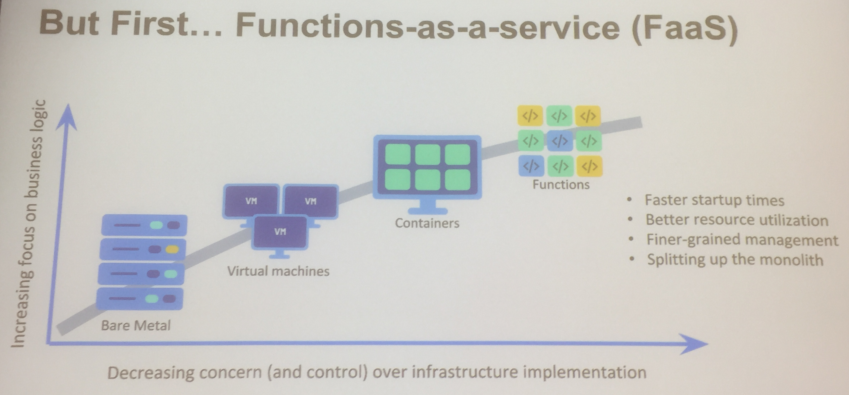

Slide 22

What is FaaS (Functions-as-a-Service)?
Functions Developer
Provide your functions code to the platform
No need to worry about servers
Functions
FaaS Platform
Functions Platform
Abstracts the notion of servers
Ensures the functions are available when invoked
Deploys, triggers, auto-scales your functions
Bills only for execution time, not for idle time

Slide 23
Introducing the Oracle Functions
Functions-as-a-Service on Oracle Cloud Infrastructure
Fully managed, multi-tenant, secure cloud service
Oracle Functions
No lock-in, open source Fn Project (FaaS Platform)
Pay per use, only for execution time, not for idle time
Notes:
Functions-as-a-Service on Oracle Cloud Infrastructure
Fully managed, multi-tenant service
No vendor lock-in - Based on the open-source Fn Project
Pay per use

Slide 24














Key Features
Open Source Engine
Container Native
Function Dev Kits
HTTP
Events
Streams
Timer
Oracle Cloud Triggers
Fine-grained Billing
Advanced Diagnostics
Notes:
Key features:
Open Source FaaS Engine – based on Fn Project
Container Native – Docker is a first class citizen. Packages and runs your functions in lightweight Docker containers
Function Development Kits – Additional set of libraries in Go, Node, Java, Ruby, Python to simplify function development
Triggers – HTTP, Events (from Oracle Cloud services like storage, database, apps like RightNow, NetSuite, etc.), Streams (Kakfa, Event Hub Cloud Service), Timer (Cron)
Pay per use – fine grained billing, pay for execution time, not for idle time
Advanced diagnostics – Platform provides details metrics and execution logs
Secure workload isolation
Auto scale
Highly available

Slide 25
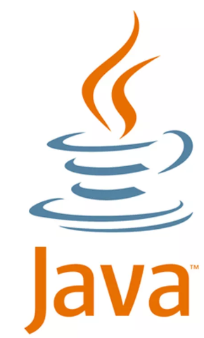




Serverless
Early 2019: Oracle Functions
Managed FaaS service
On top of OCI
Pay for sum of function execution time
Fn Project
Open Source
Possibly contribute to CNCF
25
Notes:
Sombrerome.fnproject.io

